Slide 1
Alleye
Josh Field, Blake McHale, James Tyler & Theodore Lutkus

Slide 2
Outline
The Problem
Approach
Hardware and Software
Path Planning
Guidance
Future Work

Slide 3
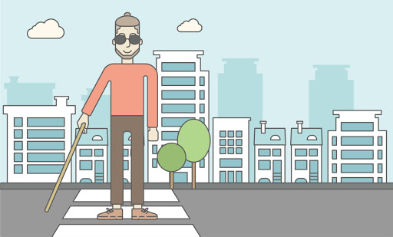
Human-Centric Design
Human 36 million people worldwide experience blindness or some form of visual impairment Individuals with visual deficits tend to have increased auditory and tactile perception | Activity Be able to navigate public spaces safely Challenges: Avoiding environmental obstacles Finding a safe path Maneuvering quickly and efficiently | Assistive Technology Current: White cane (lacks information) Guide dog (very expensive) Proposed: Use a “sighted” computer to detect obstacles and plan a safe, efficient path
Notes:
James

Slide 4
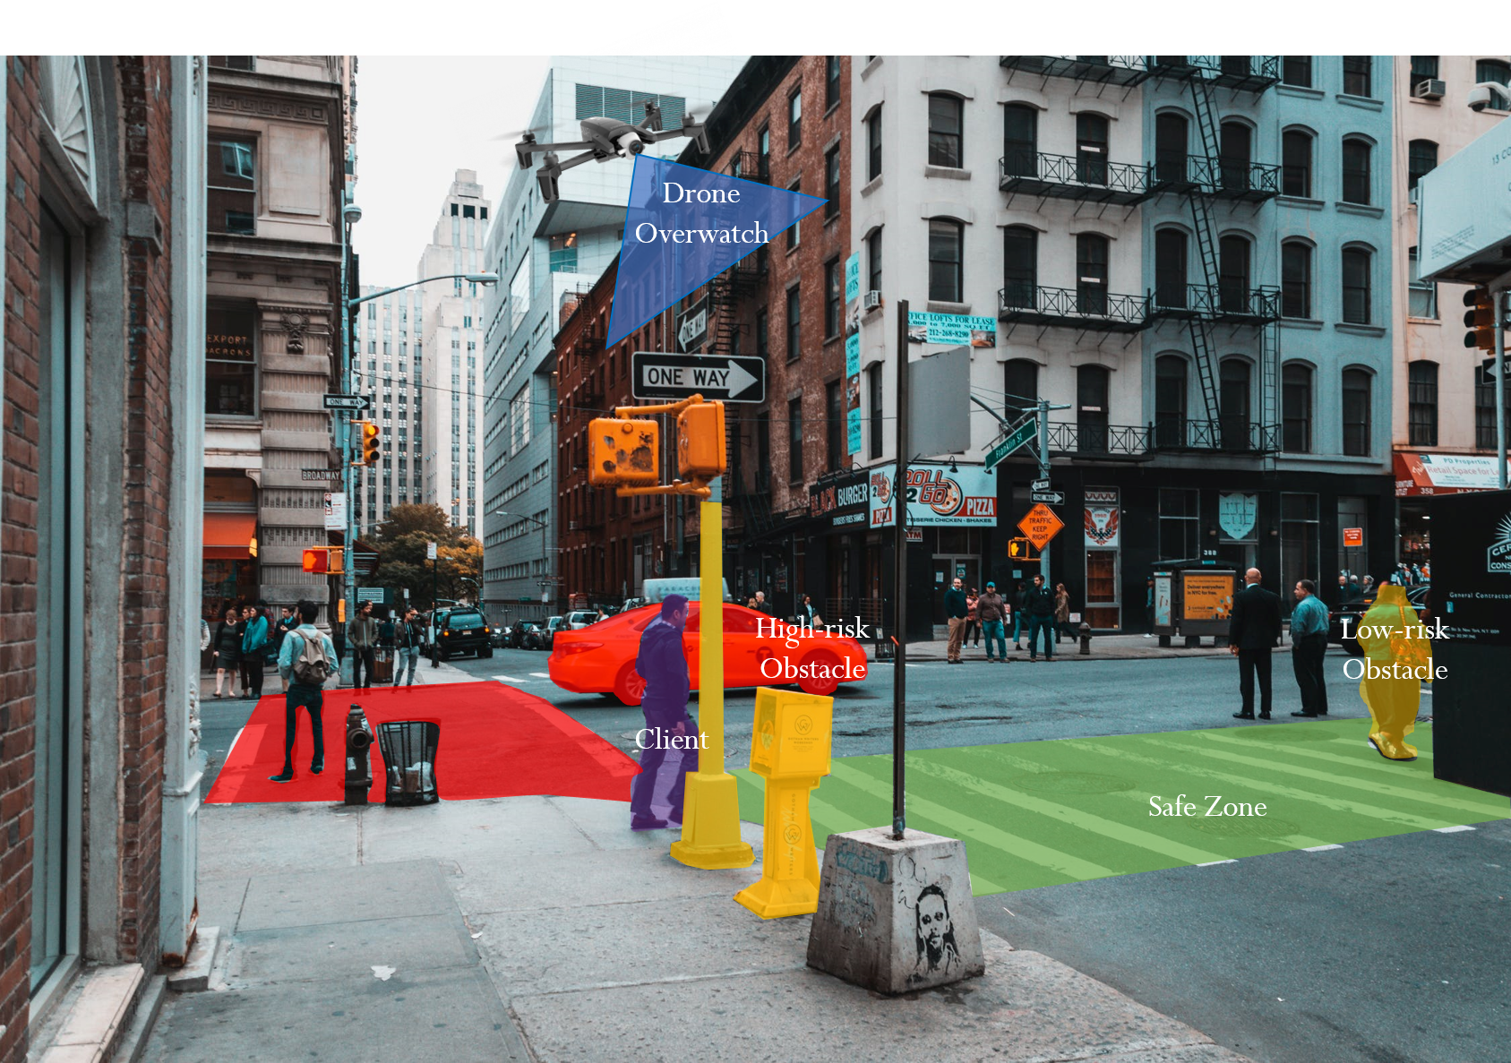
Notes:
James

Slide 5
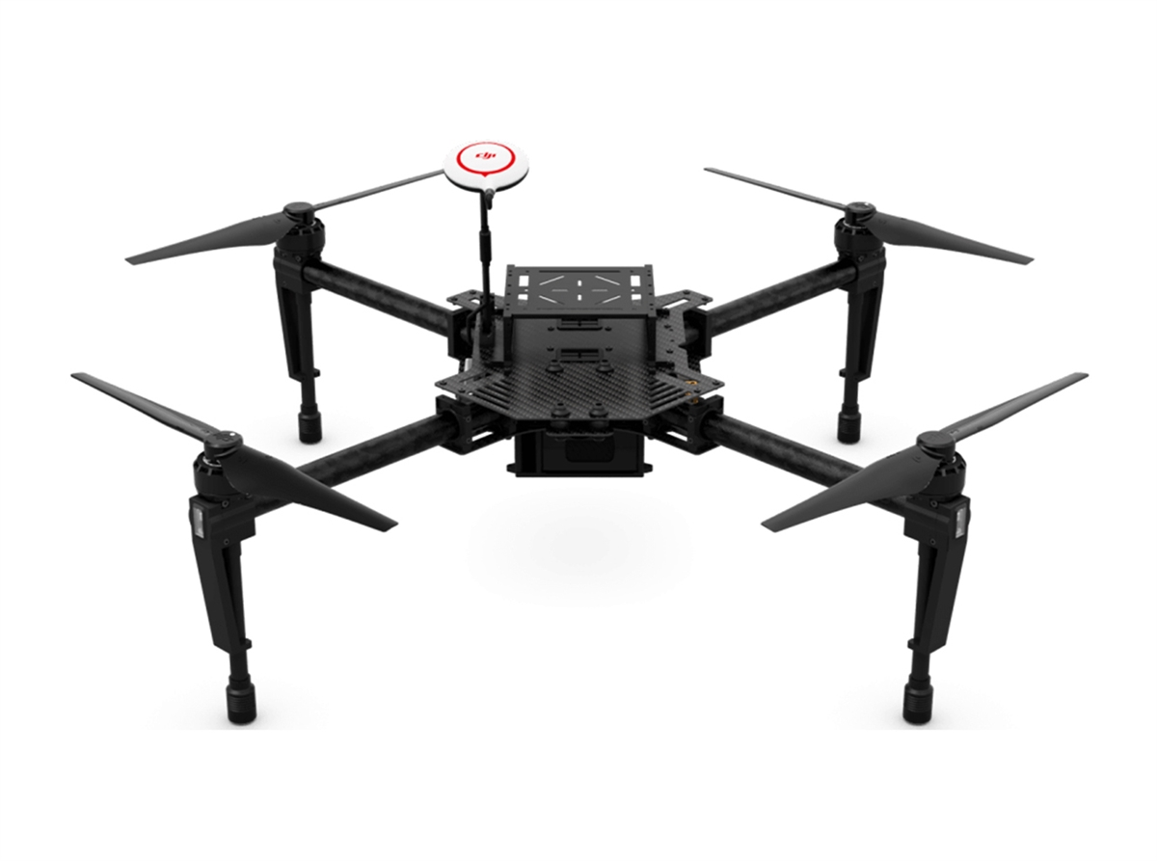
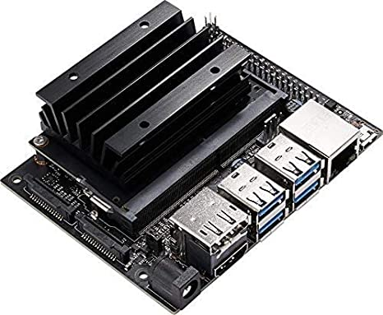
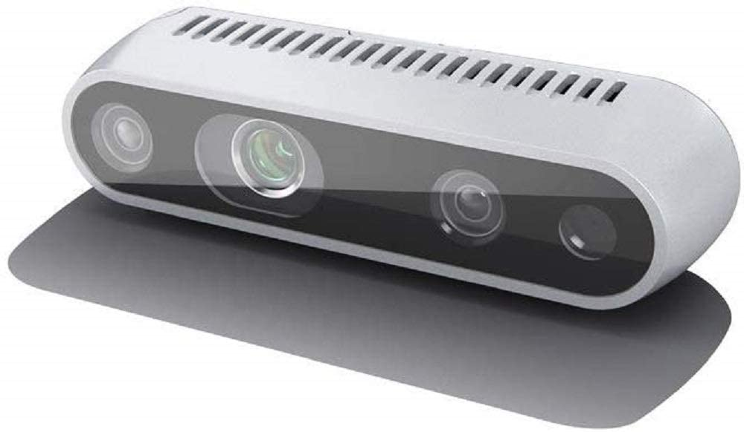
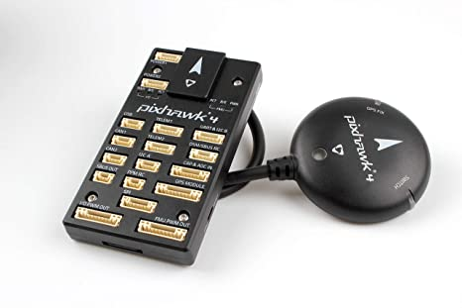
Aerial Hardware
Full Scope:
On-board computing
Jetson (Nano, TX2, Xavier, etc.)
Depth camera (Intel Realsense)
Flight controller (Pixhawk 4)
IMU
GPS
Drone platform (DJI Matrice 100)
Our Scope:
Fixed camera + simulation

Slide 6
Software Process
AprilTag Pose Estimation
Guidance Command Generation
Camera
Path Planning
Client Pose Estimation

Slide 7
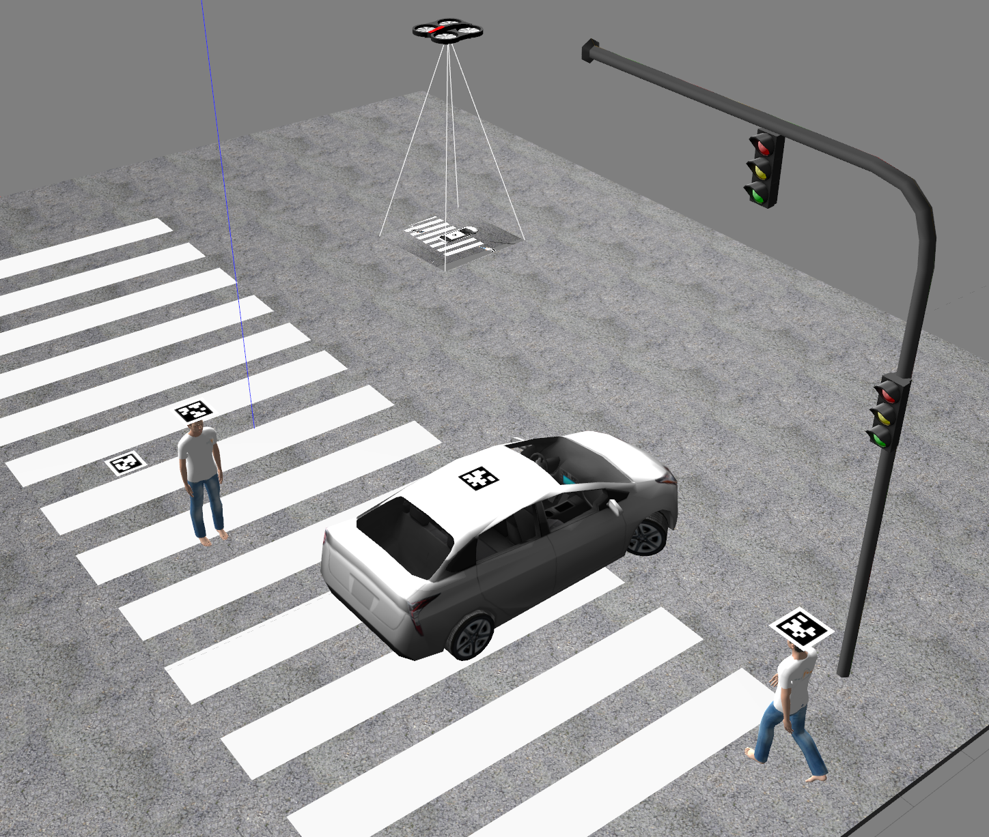
ROS and Gazebo
ROS Noetic in Ubuntu 20.04 and Gazebo11
Environment development:
Basic crosswalk world
Simplified scope using apriltags for all poses
Default Gazebo models
Gazebo static design choice
ROS development
SJTU drone package for simple services
Extended interface

Slide 8
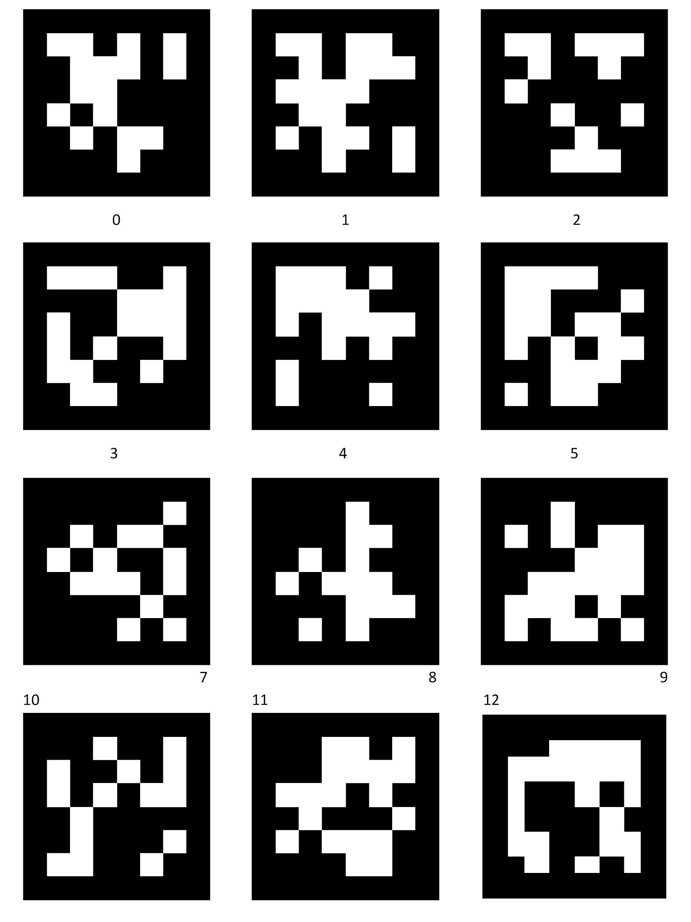
AprilTags
Apriltags_ros package
Easy to generate tags
Simple to get work with, integrated launch file
/tag_detections
Assumptions:
All obstacles are in the current camera view
Start and goal positions are also in view

Slide 9
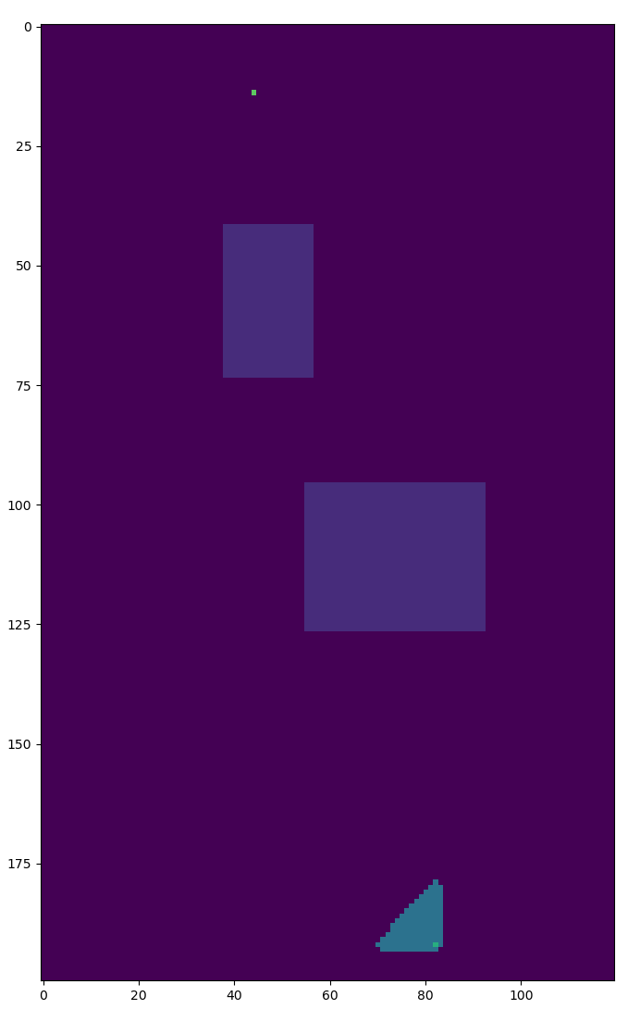
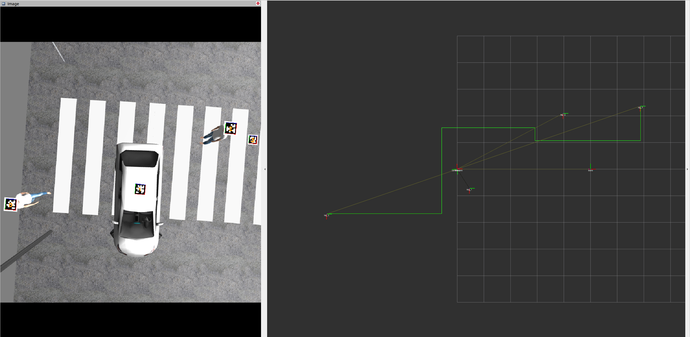
Path Planning: A*
Basic A* path planning with euclidean distance as a heuristic
Simplified scope:
Discretized grid world of obstacles
Easier to compute and visualize
Guaranteed optimal path
Bounding box config for apriltag ids
Converted back to world coords:
Path visualization
Dynamic path planning

Slide 10
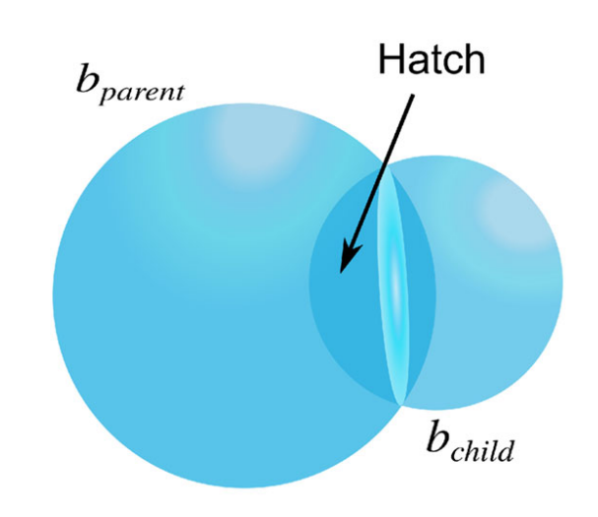
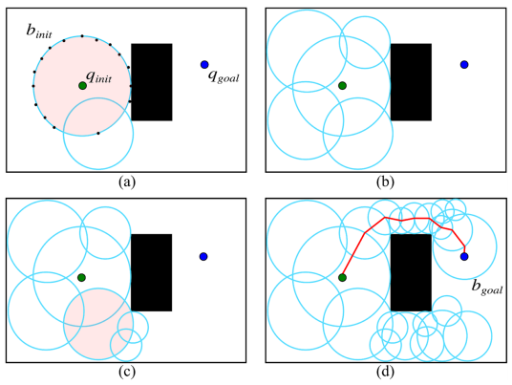
Path Planning: PFM
Probabilistic Foam Method provides a volumetric region in order to create a “safe bubble” for assistive maneuvering. (Nascimento, et al.)
These bubbles propagate, creating a safe maneuvering space

Slide 11
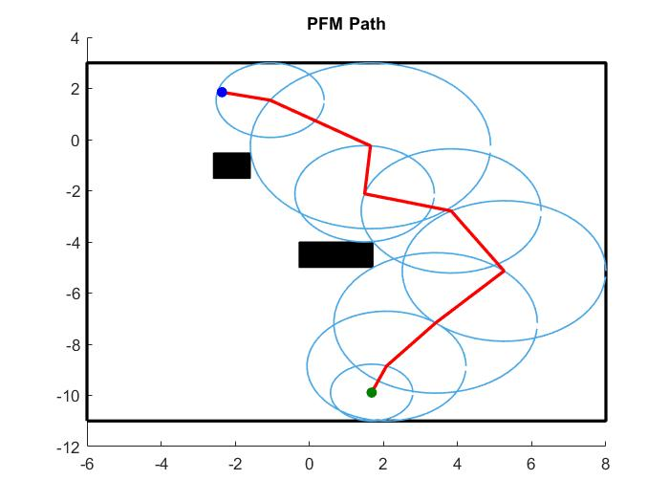
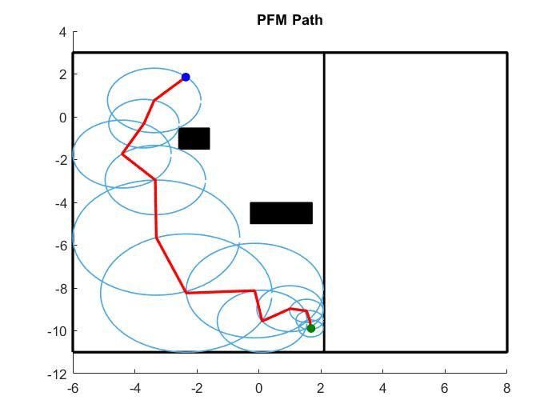
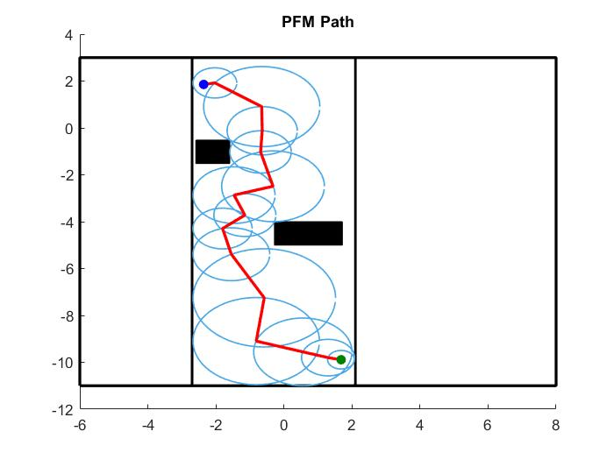
Path Planning: PFM

Slide 12
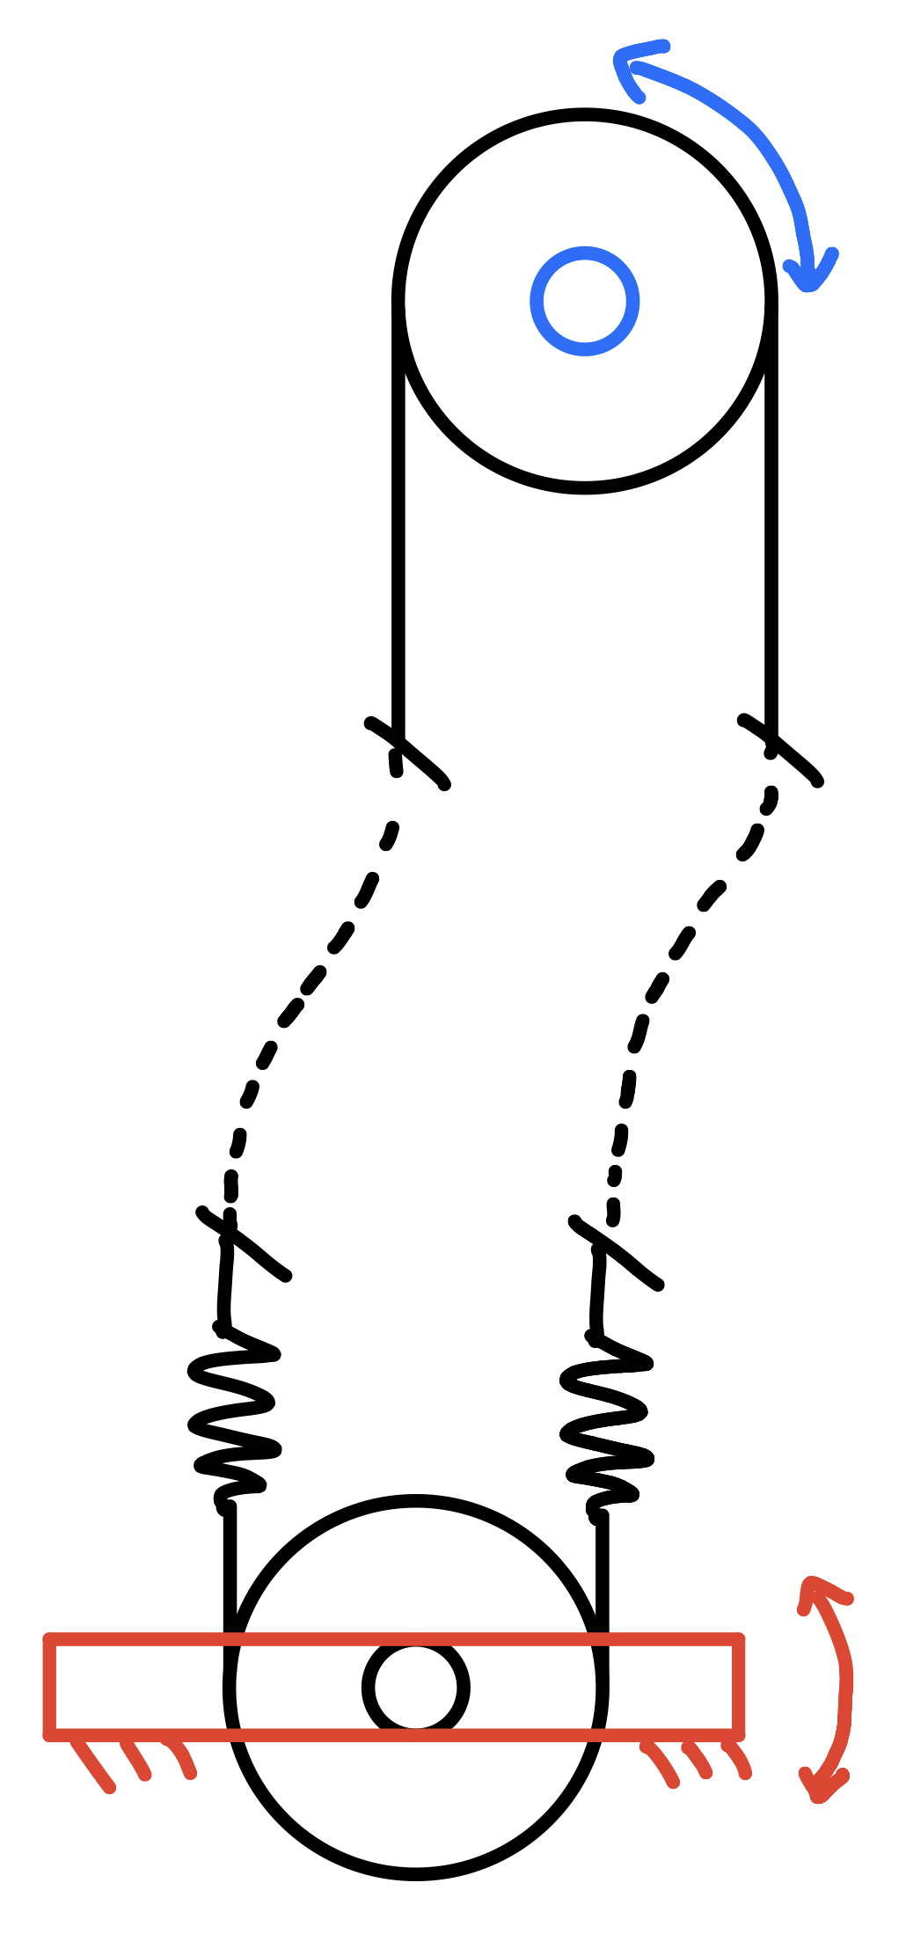
Tactile Guidance
Series elastic actuators (SEA)
Safe, compliant force to guide
Bowden cables
Flexible power transmission so client does not need to hold motor
Keeps motor and other electronics dry when raining
Motor
(Away from hand)
Bowden Cables
Elastic Springs
Output Lever (At Hand)
Move left
Move right
Notes:
Ted

Slide 13
Guidance Control
Torque controller
Hooke’s Law applied to SEA spring displacements to command torque at output lever
Servo
Angular position
+
Kp
Torque Command
Angular difference (relates spring displacement)
-
Output Lever
Angular position
Proportional Gain
Notes:
Ted

Slide 14

Notes:
Ted

Slide 15
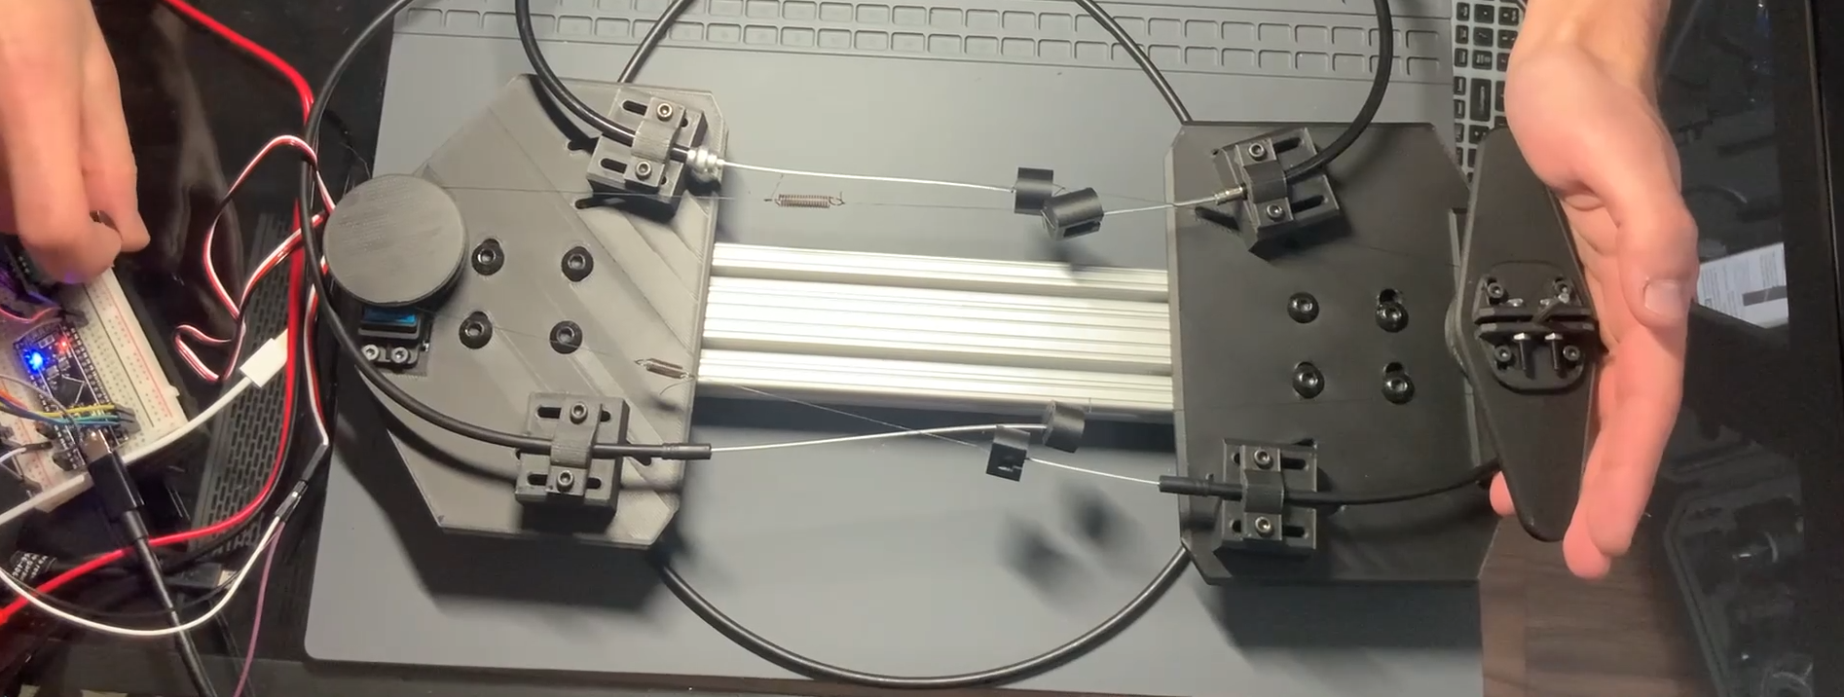
Notes:
Ted

Slide 16

Future Applications - Universal Design
Future work
Guide all individuals safely to their destination
Identify locations to avoid
Use app to give updates about plan
Generate optimal paths through residential areas
Dynamic object identification and avoidance
Notes:
Josh

Slide 17
Thank you!
Notes:
Josh

